Slide 1
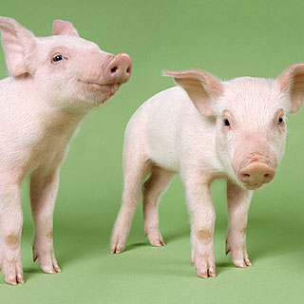
THE ROLE OF VETERINARY SERVICES DIVISION FACILITATING EXPORT OF ANIMALS AND ANIMAL PRODUCTS
Ministry of Industry, Commerce, Agriculture and Fisheries
Dr Suzan McLennon-Miguel
Senior Veterinary Specialist
Veterinary Services Division
Step By Step Guide to Exporting Workshop, JAMPRO, July 2016

Slide 2
Role of Veterinary Services Division
The responsible authority for food safety for animal based products for exports:
Ministry of Industry, Commerce, Agriculture and Fisheries
Veterinary Services Division
193 Old Hope Road
Hope Gardens
9772489/ 9772493

Slide 3
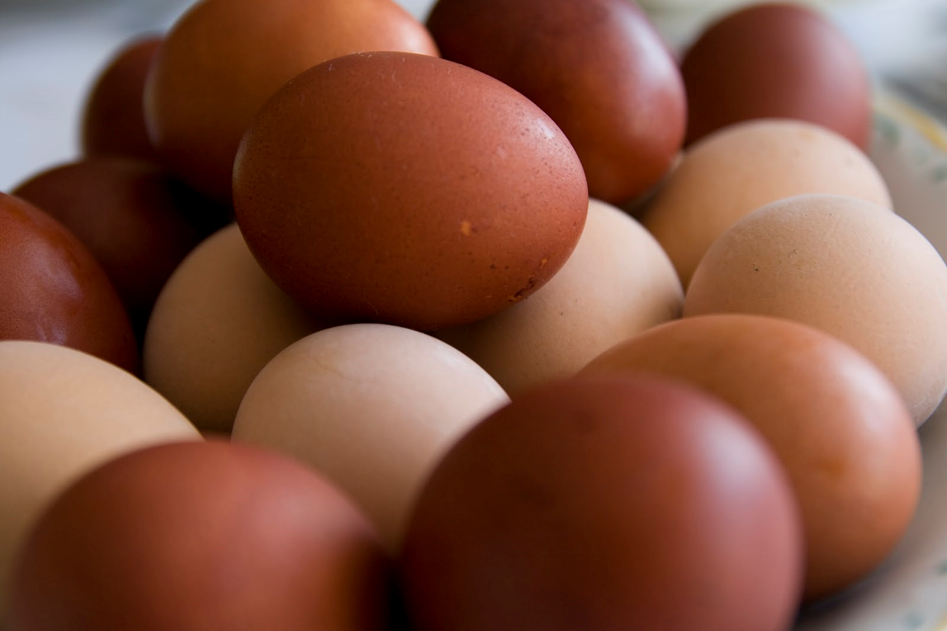
Animal Based Products
Feed
Live animals – Dogs, Cats, Poultry, Horses, cattle, Goats, Sheep, Pigs
Bee Products
Meat Products – chicken, beef, pork, seafood
Dairy Products
Egg Products
Declaration
Products that do not contain animal derivatives.

Slide 4
International requirements for exports
Every country wishing to export food of animal origin must be able to satisfy certain requirements:
animal health,
public health,
veterinary certification,
traceability system,
residues requirements,
monitoring programme within a legal framework.

Slide 5
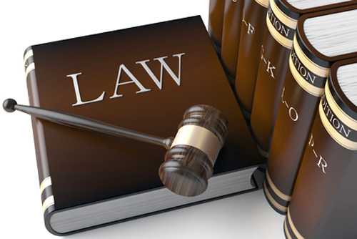
Law for Aquaculture and Fishery Products
The Aquaculture, Inland And Marine Products And By-products (Inspection, Licensing And Export) Act
The Aquaculture Inland And Marine Products And By-products Regulations, 2000

Slide 6
Law for Meat, Dairy, Egg and Bee Products
Meat, Meat Product and Meat By-Product Act 1999 (Inspection and Export)
Dairy, Egg and Bee products – International requirements

Slide 7
Role of Veterinary Services Division
International guidelines ( WHO, FAO, OIE, WTO) have indicated that the Veterinary Services role in the certification of animal products for export is to provide certification about the animal health status of the region, of origin and food safety of the product.
Review Canada, EU or FSMA requirements for importation into these countries

Slide 8
FOOD CHAIN AND ASSOCIATED HAZARDS
Biological agents
(bacteria, viruses, parasites)
Chemical Agents
Food Chain
Industry Heavy metals,
PAHS, Radionuclides
Environment
Water and soil borne pathogens
Animal Feeds
Agriculture Pesticides,
Mycotoxins,Phytotoxins
Fertilizers
Rodent, bird and
insect borne pathogens
Animals on farms
Vertical and
horizontal transmission
of pathogens
Veterinary Medicines
Drugs , Growth promoters
Transport
Live Market/Lairage
Horizontal transmission
of pathogens
Tranquilizers
Abattoir
Preservatives, additives,
biogenic amines
Processing
Faecal and Cross contamination
Storage, distribution and retail
Cross- contamination,
recontamination,
human –borne pathogens,
microbial growth
Packaging compounds
Plasticizers, Inks
Domestic, trade and retail catering
CONSUMERS

Slide 9
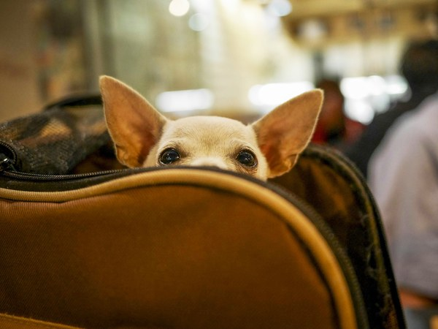
LIVE ANIMALS
Small/Companion Animals
Acquire, fill the appropriate application form and submit for processing along with the requirements for the importing country.
Take your small/companion animal to your registered private veterinarian within a week of your appointment to see the Government veterinarian.

Slide 10
LIVE ANIMALS
For your appointment – take along with you – the animal, health attestation from your private veterinarian & health record for the animal – valid ID.
Health certification granted – proceed to the Jamaica Trade Board for acquisition of a license to export.
On the day of export – veterinary quarantine inspection and sign off.

Slide 11
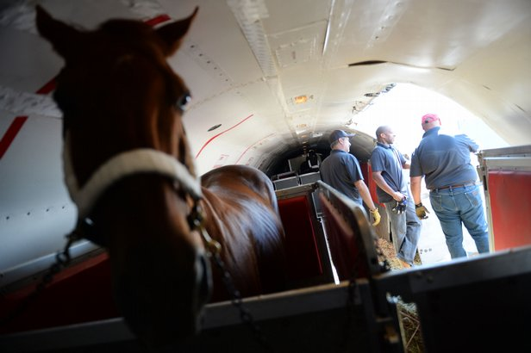
LARGE ANIMALS
Acquire, fill the appropriate application form and submit for processing along with the requirements of the importing country.
Veterinary Service Division veterinarian – guide you through quarantine

Slide 12
STEPS FOR EXPORTING ANIMALS AND ANIMAL BASED PRODUCTS

Slide 13
STEP 1
Must know the market requirements you intent to sent your products to:
Canada, EU, USA/FSMA or CARICOM requirements for importation into these countries
Review these requirements to see if you can meet them – traceability of your food safety system must be demonstrated both on paper and in infrastructure

Slide 14
STEP 1 Intended Country’s Import Requirements
Proposed country should send their import requirements.
Each consignment MUST be accompanied by a Health Certificate duly signed by an authorized Government Veterinary Officer of the country of origin to the effect that the conditions stipulated on the permit have been met.

Slide 15
STEP 1 Intended Country’s Import Requirements
Countries may change their import requirements without notice. In all cases, the exporter has the responsibility of having their importer confirm with the competent authority in the importing country the certification requirements prior to shipping.

Slide 16
STEP 2 - Export Procedures
Informing the Veterinary Services Division(VSD) by writing to the Director of their intentions to export – where from and where to , what and type of product, how?
Presentation of import requirements of the proposed importing country.
Export will be approved only if the necessary health checks on animals, animal products and by-products have been completed

Slide 17
Import requirements for USA

Slide 18
Import requirements for Cayman Islands

Slide 19
Import requirements for European Market
General Rules for Meat and Meat Products
Imports of fresh meat and meat products into the European Union are subject to veterinary certification
Based on the recognition of the competent authority of the non-EU country by the
Directorate-General for Health and Consumer
Protection.
This formal recognition of the reliability of the competent authority is a pre-requisite for the country to be eligible and authorized for export to the European Union.
Legally legitimate and adequately
empowered authorities in the exporting
country must ensure credible inspection and controls throughout the production
chain, which cover all relevant
aspects of hygiene, animal health and
public health.

Slide 20
Export Application for Health Certification

Slide 21
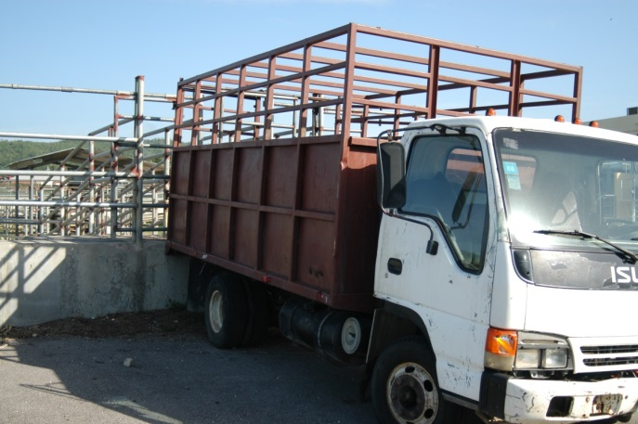
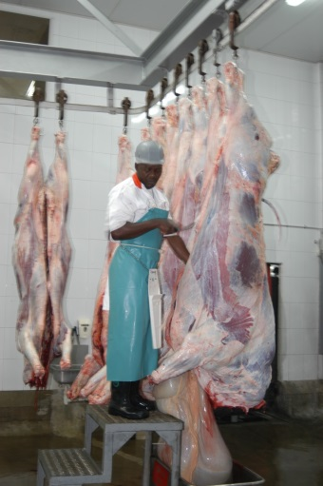
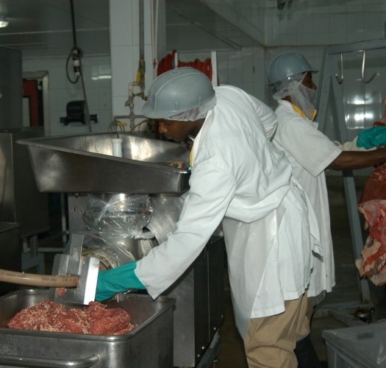
STEP 3 Registered Facilities
Farms
Hatcheries
Trucks transport animals
Feed
Veterinary Drug outlets
Slaughter facilities
Refrigerated trucks
Processing plants
Cold storage facilities
Warehouses

Slide 22
STEP 3 Registration of facilities
Inspection systems - ensure those foods, and their production systems, meet requirements in order to protect consumers against food-borne hazards.
Emergency Situations - include holding suspect products upon arrival, recall procedures, rapid notification of the problem to international bodies and possible measures to take

Slide 23
STEP 3 Registration of facilities
Documenting the System - A food import/export control system should be fully documented, including a description of its scope and operation, responsibilities and actions for staff, in order that all parties involved know precisely what is expected of them.
Registration Procedures – Each facility is required to apply for registration. Registration requirements are then given according to the operations. Audit report conduct by VSD is required for completing the registration along with the registrations documents.

Slide 24
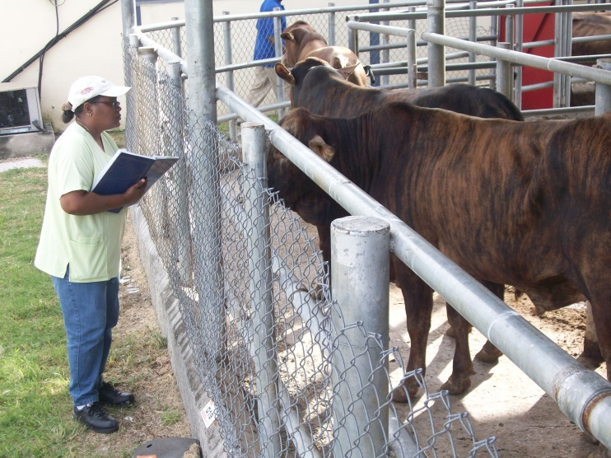
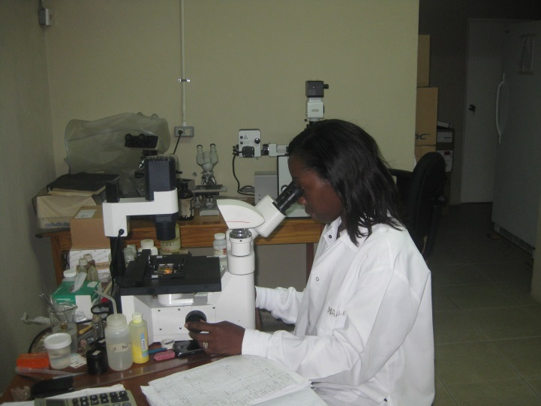
STEP 3 Registration of facilities
Monitoring Procedures - An assigned veterinary inspectors to each facility where quarterly inspections and reports are done.

Slide 25
Step 4 Checks for export by VSD inspectors
Risk analysis of Food borne hazards related to the product
Traceability of animals and animal based products
International standards for trade of animal based products
Meeting local food safety laws
Registration and Certifications of facility with VSD(GPS)
Conduct Inspections, monitoring and verifications
Own checks samples are sent to the Veterinary Laboratory for microbiology or residue testing

Slide 26
Step 3 Risk Based Systems
Development of scientific risk-based systems - influenced by WTO SPS Agreement - sanitary and phytosanitary measures shall be based on an assessment of risks to human, animal or plant life or health, taking into account risk assessment techniques developed by relevant international organizations
Global positioning system - mapping and data collection to determine the level of risk based on production activities represent the level of risk

Slide 27
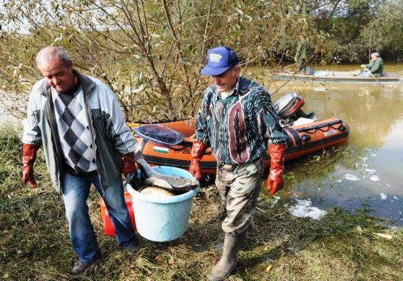
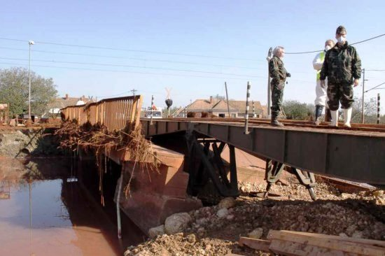
HUNGARY RED MUD SPILL
A perished fish killed by the red mud pollution in the river Marcal is seen in a bucket in Gyoer-Gyirmot, 126 kms west of Budapest, Hungary, 07 October 2010.
All living beings, animals and plants, have been killed by the pollution in this river after three days earlier a dike of a reservoir containing red mud of an alumina factory in nearby Ajka broke, and over one million cubic meters of the poisonous chemical sludge inundated three villages, killing four persons and injuring over hundred. Three people are unaccounted for and hundreds of families have been evacuated.

Slide 28
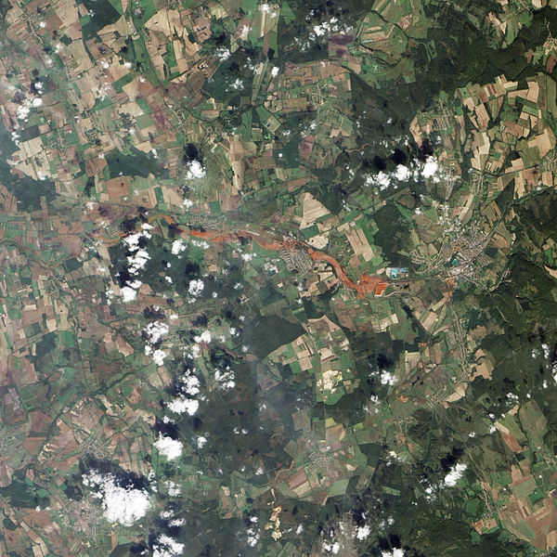
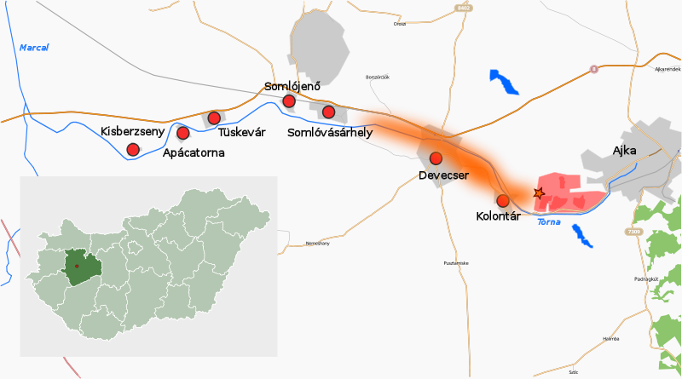
GLOBAL POSTIONING SYSTEM OF
THE RED MUD SPILL
InternetSource : http://en.wikipedia.org/wiki/File:Ajkai_v%C3%B6r%C3%B6siszap-katasztr%C3%B3fa_v%C3%A1zlat_2010-10-04.svg
Ajkai_vörösiszap-katasztrófa_vázlat_2010-10-04.svg‎ (SVG file, nominally 1,732 × 964 pixels, file size: 309 KB)

Slide 29
Step 5 Health certificate or Attestation Letter
Will be granted based on the following :
Registered Facility
Food Safety system
Processing Facility/product monitoring report(s)
Processing and Product report(s) for single shipment(when applicable)
Good laboratory result(s)
Satisfying the importing country’s requirements.

Slide 30
Conclusion
Step 1 -Must know you Market requirements
Step 2- Contact Veterinary Services Division – intent to export
Step 3 -Food Safety plan indicating traceability of your product form “farm to Fork” is your responsibility .
Good Agricultural Practices
On Farm Food Safety Programmes
Animal Welfare concerns
National Residue Control programme
Food Safety systems – Animal Identification and Traceability
Step 4 – Registration and Inspection - verification
Step 5 -The exporter should obtain any required certificates prior to shipping. Most countries will not accept certificates issued after consignments have shipped.

Slide 31
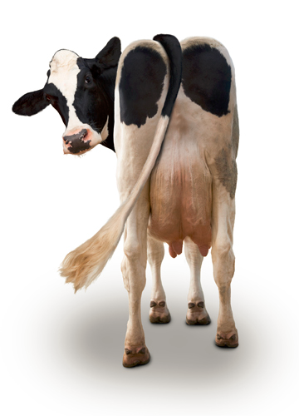
THE END
Ministry of Industry, Commerce, Agriculture & Fisheries
Veterinary Services Division
193 Old Hope Road
Kingston 6
Jamaica W.I
Telephone : 876-977-2489 / 92
Fax : 876-977-0885
E-mail: vsd@moa.gov.jm
www.moa.gov.jm

